Slide 1

Chapter 8
Collaboration Strategies
Strategic Management of Technological Innovation, 7th Edition
Melissa A. Schilling
© McGraw Hill LLC. All rights reserved. No reproduction or distribution without the prior written consent of McGraw Hill LLC.

Slide 2
Zeta Energy and “The Holy Grail” of Batteries 1
In 2021, Zeta Energy had developed a lithium metal battery that had an extremely high energy density, long life, and much lower cost than traditional lithium-ion batteries. The batteries were also recyclable and did not use cobalt (a politically sensitive and expensive material).
Demonstrating commercial scale of the batteries, however, required $100 million for the factory, equipment, and personnel.
There was considerable uncertainty about which battery technology(ies) would succeed, making investors wary. Furthermore, the founder was reluctant to go to venture capitalists because he did not want to give up significant control of the firm.
Zeta was considering several different types of collaboration to gain access to needed resources: chemical firms, consumer electronics firms, the government, other battery companies etc. Which, if any, made the most sense?

Slide 3
Zeta Energy and “The Holy Grail” of Batteries 2
Discussion Questions:
What are the pros and cons of Zeta Energy collaborating with another organization?
What type of potential partner offers the most “resource fit” for Zeta Energy? What type of potential partner offers the most “strategic fit” for Zeta Energy? Is there a collaboration partner you would recommend?
If Zeta Energy entered into a collaboration, what type of collaboration structure (for example, R&D alliance, joint venture, licensing, outsourcing, etc.) should it use? What would you recommend to Zeta Energy about governance of the collaboration?

Slide 4
Overview
Firms must often choose between performing innovation activities alone or in collaboration.
Collaboration can enable firms to achieve more, at a faster rate, and at less cost and risk.
However, collaboration also entails sharing control and rewards, and may risk partner malfeasance.
The advantages of going solo are compared with those of collaborating, and then different forms of collaboration are compared.

Slide 5
Reasons for Going Solo
Whether a firm chooses to engage in solo development or collaboration will be influence by:
Availability of capabilities (does firm have needed capabilities in house? Does a potential partner?).
Protecting proprietary technologies (how important is it to keep exclusive control of the technology?).
Controlling technology development and use (how important is it for firm to direct development process and applications?).
Building and renewing capabilities (is the project key to renewing or developing the firm’s capabilities?).

Slide 6
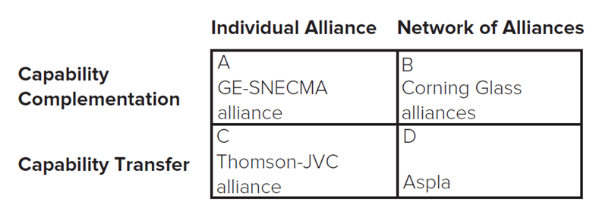
Types of Collaborative Arrangements 1
There are numerous types of collaborative arrangements, each with its own advantages or costs.
Strategic Alliances: formal or informal agreements between two or more organizations (or other entities) to cooperate in some way.
Doz and Hamel note that a firm’s alliance strategy might emphasize combining complementary capabilities or transferring capabilities. It might also emphasize individual alliances or a network of alliances.
Access the text alternative for these images.

Slide 7
Types of Collaborative Arrangements 2
Joint Ventures: A particular type of strategic alliance that entails significant equity investment and often establishes a new separate legal entity.
Licensing: a contractual arrangement that gives an organization (or individual) the rights to use another’s intellectual property, typically in exchange for royalties.
Outsourcing: When an organization (or individual) procures services or products from another rather than producing them in-house.
Collective Research Organizations: Organizations formed to facilitate collaboration among a group of firms.

Slide 8
Choosing a Mode of Collaboration 1
Firms should match the trade-offs of a collaboration mode to their needs.
Blank | Speed | Cost | Control | Leverages Existing Competencies | Develops New Competencies | Accesses Other Firms’ Competencies
Solo Internal Development | Low | High | High | Yes | Yes | No
Strategic Alliances | Varies | Varies | Low | Yes | Yes | Sometimes
Joint Ventures | Low | Shared | Shared | Yes | Yes | Yes
Licensing In | High | Medium | Low | Sometimes | Sometimes | Sometimes
Licensing Out | High | Low | Medium | Yes | No | Sometimes
Outsourcing | Medium | Medium | Medium | Sometimes | No | Yes
Collective Research Organizations | Low | Varies | Varies | Yes | Yes | Yes

Slide 9
Choosing a Mode of Collaboration 2
Partner Selection.
Resource fit: How well does the potential partner fit the resource needs of the project? Are resources complementary or supplementary?
Strategic fit: Does the potential partner have compatible objectives and styles?
Impact on Opportunities and Threats: How would collaboration impact bargaining power of customers and suppliers, degree of rivalry, threat of entry or substitutes?
Impact on Internal Strengths and Weaknesses: Would collaboration enhance firm’s strengths? Overcome its weaknesses? Create a competitive advantage?
Impact on Strategic Direction: Would the collaboration help the firm achieve its strategic intent?

Slide 10
Choosing and Monitoring Partners 1
Partner Monitoring and Governance.
Successful collaborations require clear yet flexible monitoring and governance mechanisms.
May utilize legally binding contractual arrangements.
Helps ensure partners are aware of rights and obligations.
Provides legal remedies for violations.
Contracts often include:
What each partner is obligated to contribute.
How much control each partner has in arrangement.
When and how proceeds of collaboration will be distributed.
Review and reporting requirements.
Provisions for terminating relationship.

Slide 11
Choosing and Monitoring Partners 2
May also use shared equity ownership (that is, each partner contributes capital and owns a share of equity in the alliance).
Helps to align incentives and provide sense of ownership.
May rely on relational governance (self-enforcing governance based on the goodwill, trust, and reputation of partners).
Built over time.
Can facilitate more extensive cooperation, sharing, and learning by partners.

Slide 12
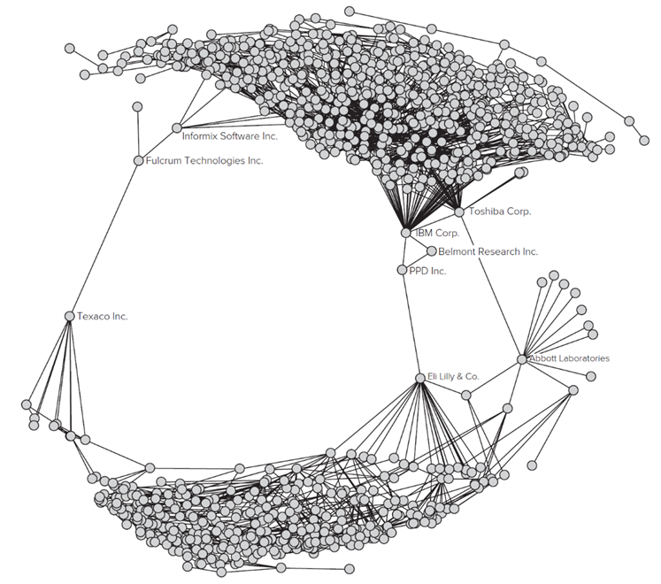
Research Brief
Strategic Positions in Collaborative Networks.
A firm’s position within a collaborative network influences its access to information and other resources, and its influence over desired outcomes. Some of the key aspects of a firm’s position include centrality and opportunities for brokerage. For example, in this graph, though P P D Inc. has only three alliances, it serves as an important bridge between the two lobes of the network, which should give it important opportunities for brokerage.
Access the text alternative for these images.

Slide 13
Discussion Questions
What are some of the advantages and disadvantages of collaborating on a development project?
How does the mode of collaborating (for example, strategic alliance, joint venture, licensing, outsourcing, collective research organization) influence the success of a collaboration?
Identify an example of collaboration between two or more organizations. What were the advantages and disadvantages of collaboration versus solo development? What collaboration mode did the partners choose? What were the advantages and disadvantages of the collaboration mode?
If a firm decides it is in its best interest to collaborate on a development project, how would you recommend the firm go about choosing a partner, a collaboration mode, and governance structure for the relationship?

Slide 14
Supplementary Video
Short Videos on:
Innovation Strategy: Collaboration Types.
https://youtu.be/tJlJJhPJHs0
Innovation Strategy: Collaboration Partners and Governance.
https://youtu.be/EHULUlCYOUQ

Slide 15
End of Main Content
© McGraw Hill LLC. All rights reserved. No reproduction or distribution without the prior written consent of McGraw Hill LLC.

Slide 16
Accessibility Content: Text Alternatives for Images

Slide 17
Types of Collaborative Arrangements 1 – Text Alternative
Return to parent-slide containing images.
Row 1 has column headers, individual alliances and a network of alliances. Column 1 has row headers, capability complementation and capability transfer. Row 1, columns 2 and 3 read: A, G E, S N E C M A alliance. B, Corning Glass alliances. Row 2, columns 2 and 3 read: C, Thomson J V C alliance. D, Aspla.
Return to parent-slide containing images.

Slide 18
Research Brief – Text Alternative
Return to parent-slide containing images.
Informix Software Incorporated leads to numerous line segments, out of which most of them lead to I B M Corporation and Toshiba Corporation. I B M Corporation is interconnected to Belmont Research Incorporated and P P D Incorporated, that further leads to Eli Lilly and Company. Toshiba Corporation leads to Abbott Laboratories, that is further linked to Eli Lilly and Company. Eli Lilly and Company further leads to Texaco Incorporated and Fulcrum Technologies Incorporated, that leads to Informix Software Incorporated.
Return to parent-slide containing images.

